Slide 1
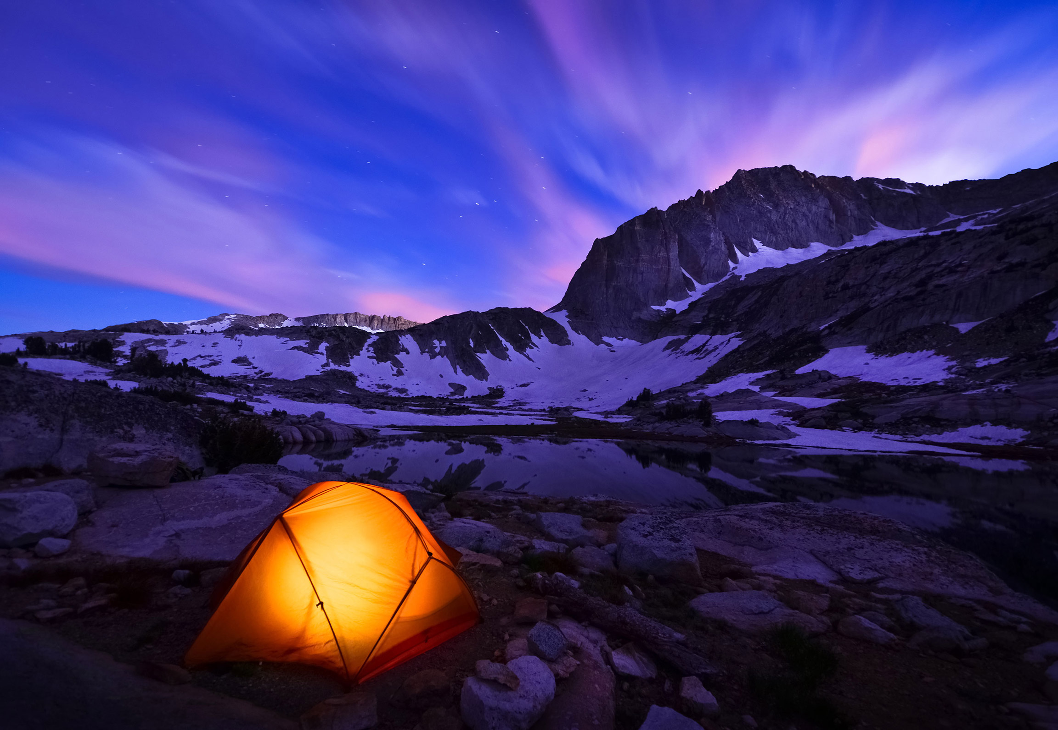
A web based application to ensure a healthy and fun experience throughout the world
Smart Travel & Events

Slide 2

An application used to show weather conditions and events in the area that will optimize user experience in any given place.
Weather informations detailed with general conditions, temperature, and UV index- up to a five day forecast is available.
Enter any location throughout the world using a zip code, city name, or street address and gain information regarding events and weather.
Events are made available through Eventbrite, weather information is made available through Accuweather, and air conditions are made available through Airpollution. Exterior library leaflet.js used for mapping.
Smart Travel & Events

Slide 3




Garrett- JavaScript, jQuery, Ajax Eventbrite, Ajax, Accuweather, Ajax Airpollution,
David- JavaScript, jQuery, Ajax Eventbrite, Ajax, Accuweather, Ajax Airpollution, Exterior library leaflet for map.
Emma- HTML, Custom CSS, Wireframe, Bootstrap.
Shanekia- HTML, Custom CSS, Bootstrap.
Our Team (Team Brachiosaurus)

Slide 4
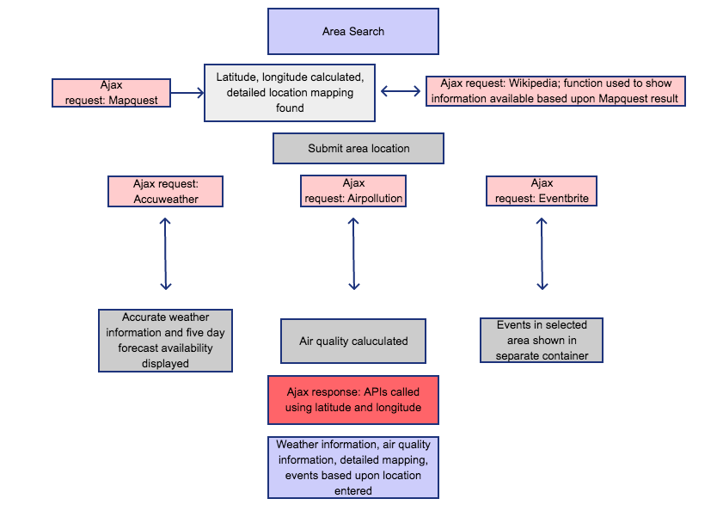
Smart Travel & Events Dataflow

Slide 5
List of Technologies used

Slide 6
Future Updates
Directions to events
Selection for free events vs paid events
User profiles; tailored events

Slide 7

Questions?
special thanks to Kevin Steele

